Slide 1
Rust Cargo & Data Types
Week 3

Slide 2
What is Cargo?
Cargo is Rust’s build system and package manager.
Most Rustaceans use this tool to manage their Rust projects because Cargo handles a lot of tasks for you, such as
building your code,
downloading the libraries your code depends on and
building those libraries.
Cargo comes installed with Rust if you used the official installers
Check whether Cargo is installed by entering the following into your terminal:
$ cargo --version

Slide 3
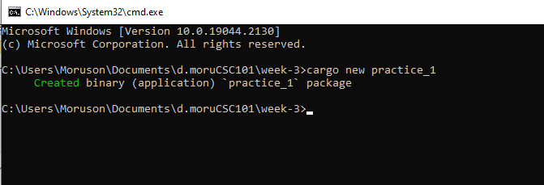
Creating a Project with Cargo
Navigate to your cloned repository/directory (C:\Users\Moruson\Documents\d.moruCSC101\week-3).
Then, from the command prompt (cmd), run the following:
Create Project

Slide 4
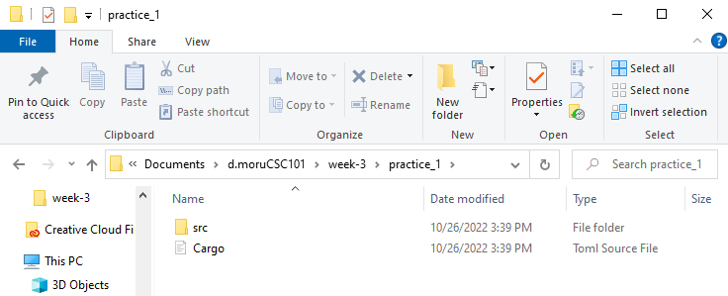
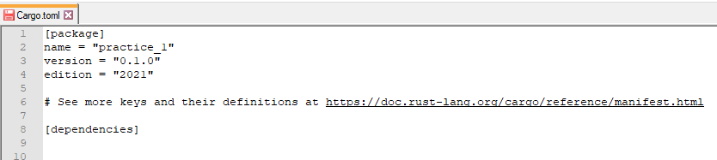
Creating a Project with Cargo
Open practice_1 folder created
Open the Cargo.toml file with notepad
(The .toml file is a Rust configuration file)

Slide 5
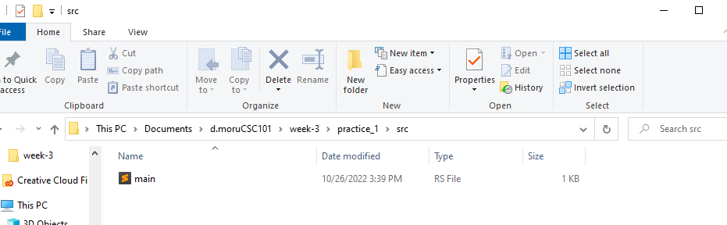
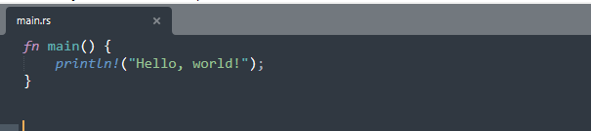
Creating a Project with Cargo
Open src folder
Open the main.rs file
Code created automatically

Slide 6
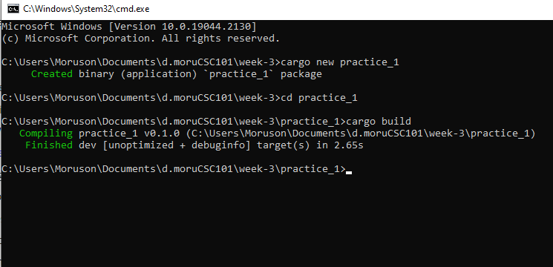
Building a Cargo Project
Create Project
Change to Directory
Build Project

Slide 7
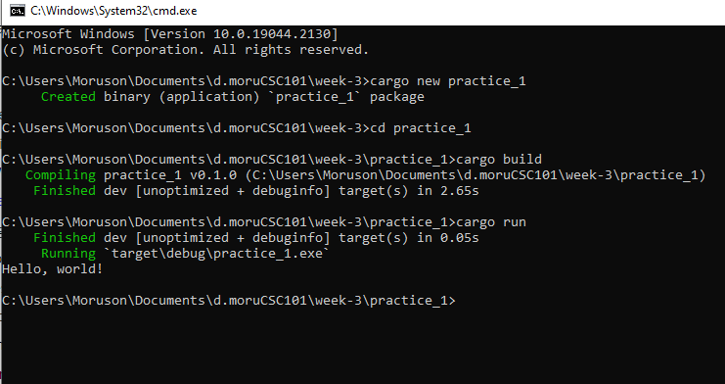
Run a Cargo Project
Run Project

Slide 8
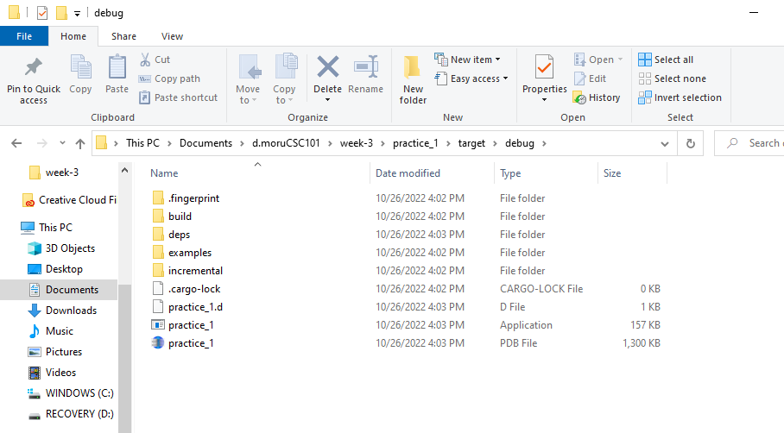
Track Compiled Files
Track file
.exe file

Slide 9
What is a Data Type?
Rust is a statically typed language.
Every value in Rust is of a certain data type.
The compiler can automatically infer data type of the variable based on the value assigned to it.
The Type System represents the different types of values supported by the language.
This ensures that the code behaves as expected.
The Type System checks validity of the supplied values, before they are stored or manipulated by the program.
The Type System further allows for richer code hinting and automated documentation too.

Slide 10
Rust Data (Scalar) Type?
A scalar type represents a single value. For example, 10,3.14,'c'.
Rust has four primary scalar types.
Integer
Floating-point
Booleans
Characters

Slide 11
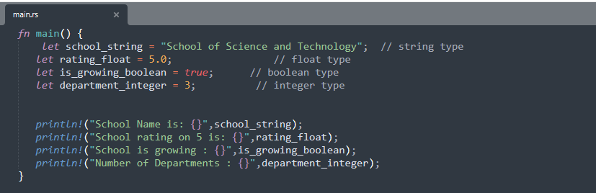
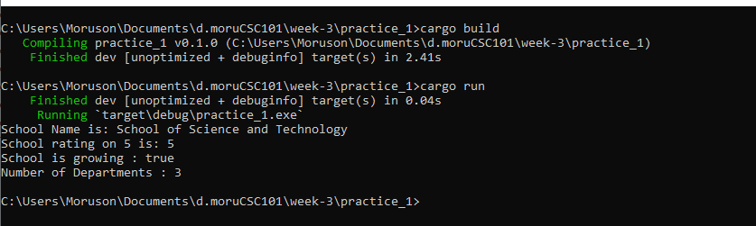
Declare Variables
Practice 1: week-3/practice_1/src/main.rs
Output:
Build Project
Output:
Run Project

Slide 12
Integer Data Type
An integer is a number without a fractional component. Simply put, the integer data type is used to represent whole numbers.
Integers can be further classified as Signed and Unsigned. Signed integers can store both negative and positive values. Unsigned integers can only store positive values.
Sr. No. | Size | Signed | Unsigned
1 | 8 bit | i8 | u8
2 | 16 bit | i16 | u16
3 | 32 bit | i32 | u32
4 | 64 bit | i64 | u64
5 | 128 bit | i128 | u128

Slide 13
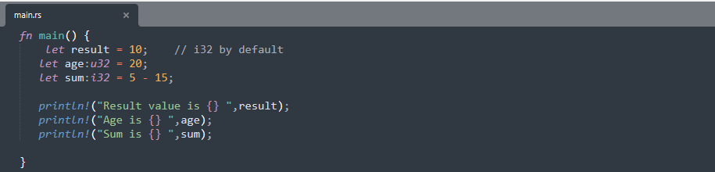
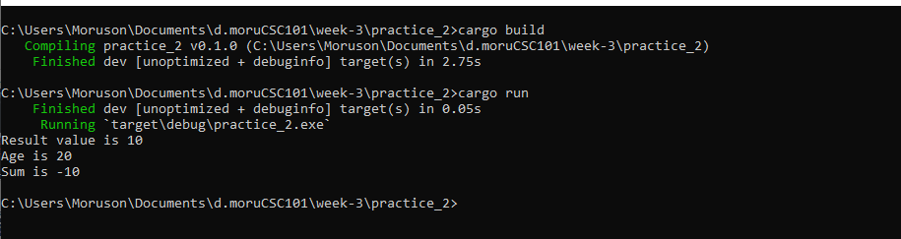
Declare Variables
Practice 2: week-3/practice_2/src/main.rs
Output:

Slide 14

Float Data Type
Float data type in Rust can be classified as f32 and f64.
The f32 type is a single-precision float, and f64 has double precision. The default type is f64
Practice 3: week-3/practice_3/src/main.rs

Slide 15
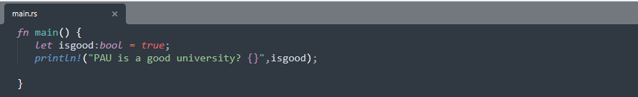
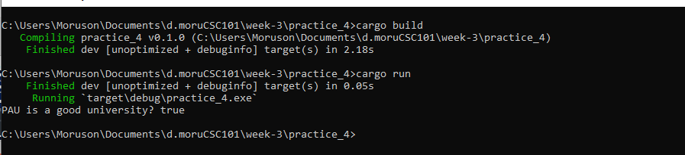
Boolean Data Type
Boolean types have two possible values – true or false. Use the bool keyword to declare a boolean variable.
Practice 4: week-3/practice_4/src/main.rs
Output:

Slide 16
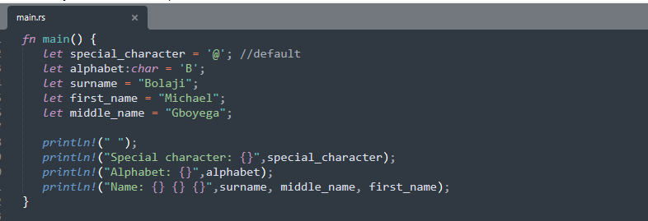
Character & String Data Type
The character data type in Rust supports numbers, alphabets and special characters. Use the char keyword to declare a variable of character data type. Rust’s char type represents a lot more than just ASCII.
Practice 5: week-3/practice_5/src/main.rs

Slide 17
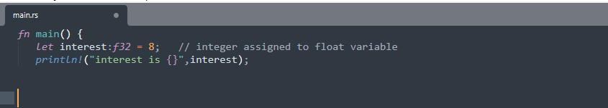
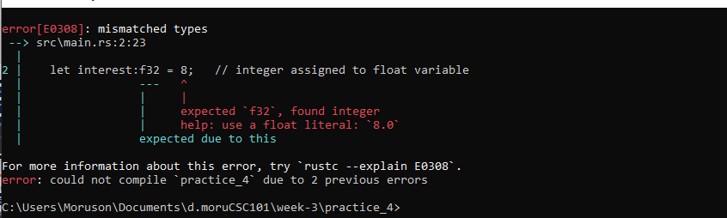
Type Casting
Automatic type casting is not allowed in Rust. Consider the following code snippet. An integer value is assigned to the float variable interest.
Practice 6: week-3/practice_6
Output:

Slide 18
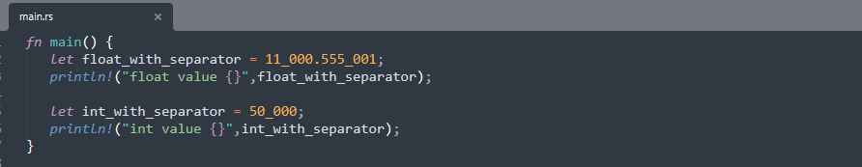
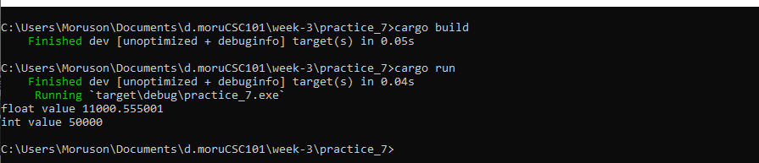
Number Separator
For easy readability of large numbers, we can use a visual separator _ underscore to separate digits. That is 50,000 can be written as 50_000 .
Practice 7: week-3/practice_7/src/main.rs
Output:

Slide 19
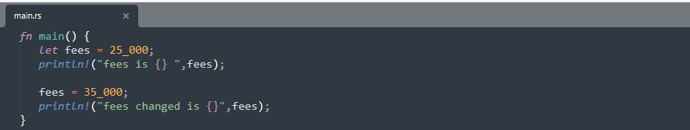
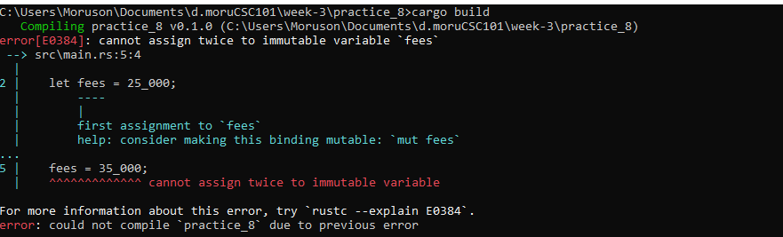
Variables and Mutability
By default, variables are immutable − read only in Rust. In other words, the variable's value cannot be changed once a value is bound to a variable name.
Practice 8: week-3/practice_8/src/main.rs
Output:

Slide 20
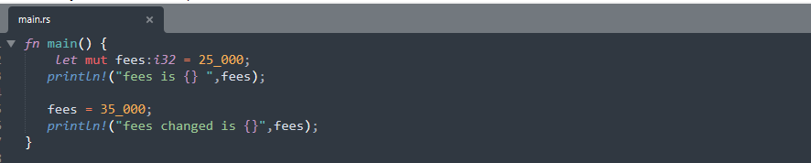
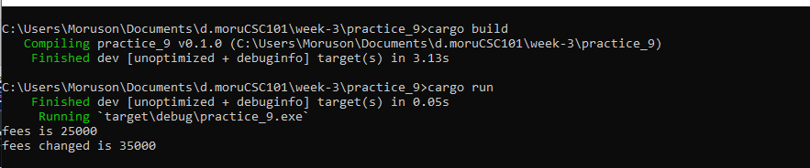
Variables and Mutability
To make a variable mutable, prefix the variable name with mut keyword. The value of a mutable variable can be changed.
Practice 9: week-3/practice_9/src/main.rs
Output:

Slide 21
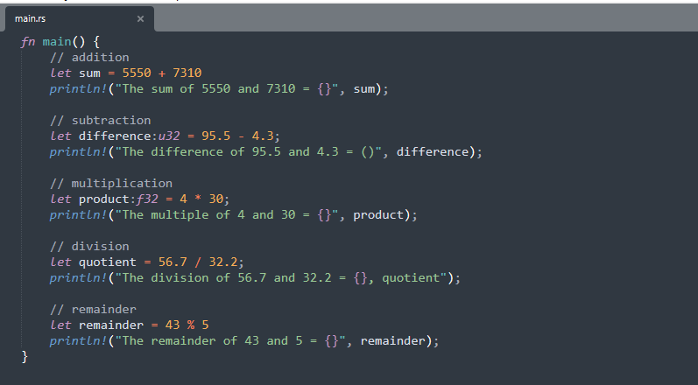
Debug the program
Practice 10:

